Slide 1

DriverPass System Analysis
Dylan Cavazos
Notes:
[No speaker notes required for this slide.]

Slide 2

System Requirements
Functional Requirements:
The system shall offer users the ability to make reservations by scheduling a date and time.
The system shall provide test progress for users by displaying current user progress, test name, time taken, current score, and status.
Non-Functional Requirements:
The system should update regularly along with updating to reflect changes associated with DMV policies.
User authentication will be verified upon login of the system, role-based access control will be implemented to differentiate between users with special privileges granted to users labeled as “Administrator” or “Instructor”.
Notes:
[In your speaker notes, include an explanation of the different requirements you determined for DriverPass’s system. What are the functional requirements you selected to describe? What are the nonfunctional requirements you selected to describe? Be sure to explain how these requirements meet DriverPass’s needs.]
The Functional requirements I selected for DriverPass included the ability for the system to offer a reservation tool that allows users to schedule both a time and date as per the specified requirements. Another functional requirement was the ability for users, specifically students, to view their test progress and they complete various lessons. The test progress will display various information such as the users current progress, the relevant test, the amount of time, current score, and the status of the user. These functional requirements both allow the user to properly engage with the DriverPass system and can aptly have a successful experience that fulfills the necessary requirements for the system. The user should be able to have success in creating a reservation and accessing their account to view their relevant activity.
The Non-Functional requirements I selected pertain to the system’s need to be compatible with DMV policies. This will ensure that information related to the DMV will coincide with the information that DriverPass is including in its online material. The other non-functional requirement revolves around the system’s ability to differentiate between various users of the system. This will ensure that proper role-based access control is adhered to, effectively partitioning the access to the system between standard users and Administrators of the system. This differentiation helps to establish secure access to the system for proper maintenance and security of the system.

Slide 3
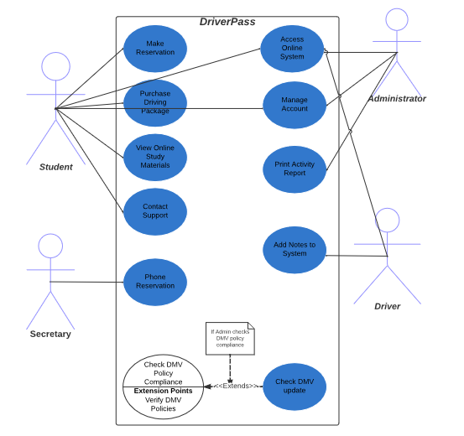
Use Case Diagram
Notes:
[Explain your diagram. Who are the different actors in the system? What are the different use cases? How did you account for DriverPass’s needs in your design? In your explanation, keep your audience in mind. Avoid the use of terms like “actors” and “use cases” in your explanation.]
This diagram lays out the various users of the system and how they will interact with the DriverPass system. For instance, DriverPass will allow multiple users to engage with it including, any Students or Customers, The administrator or IT personnel, the Drivers, and the Secretaries. For the student, which is the sole focus of the DriverPass, the student will include scenarios like being able to make a reservation, Purchase various Driving packages, view their online study materials, and contact online support. The Administrator will have similar uses for the system like being able to access the online cloud-based system, manage accounts for things like resetting passwords, blocking accounts, etc. They can also print activity reports to view updates to the reservation system. The drivers will be able to access the system by adding notes to students accounts for areas of improvement, and pair themselves with available students in their local area. The secretary is primarily focused on scheduling reservations for users that call in to schedule and provide the necessary information. The system also will require the need to adhere to DMV policies and rules, so the system will account for this by having consistent updates whenever the DMV makes an update as well. In my design I included many of the primary functions that the users will require to access the DriverPass system and incorporated elements that will allow them to perform various functions.

Slide 4
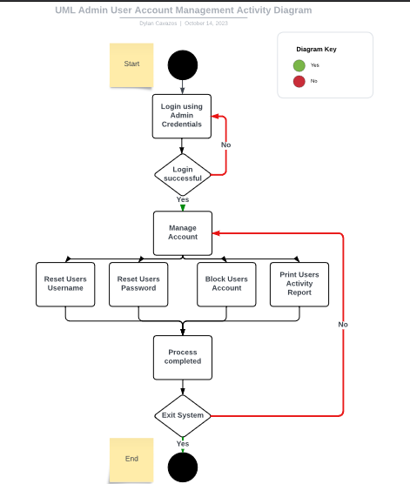
Activity Diagram
Notes:
[Explain your diagram. Which use case are you breaking down? What are the steps for this use case? How did you account for DriverPass’s needs in your design? In your explanation, keep your audience in mind. Avoid the use of technical terms such as “nodes,” “control flows,” and so on.]
In this diagram, I wanted to break down the Administrators use of the system and their specific privileges and functions. The diagram outlines multiple steps to account for this, for example, the user logins to the system using their Administrator credentials, which is then verified by the system. If successful, the system grants them specific privileges, allowing the Admin to manage users’ accounts. Once confirmed, the admin can reset a user's username, reset their password, block a user’s account, and print an activity report of various users' activities and reservation status. Once the admin has completed the necessary function, the system verifies if the admin is finished with their access, if so then the admin exits the system. This design helps to account for DriverPass’s needs by illustrating the requirements for role-based access control such as the administrator making specified modifications to the system as outlined in the requirements document.

Slide 5
Security
User authentication: Including user authentication in DriverPass is essential to ensuring secure access to the system. Typically, by implementing a username and password for each user.
Account management: Providing the necessary ability for IT or an Administrator to manage user accounts, prevents unnecessary access to the system.
Password recovery: Password Recovery in DriverPass allows the users to implement user authentication practices to reset their password when needed.
Monitoring and Alerts: Including a monitoring an alert system for DriverPass helps the support and Administrative staff in evaluating threats to prevent unauthorized access.
Notes:
[How did you consider security in your design? In your explanation, keep your audience in mind by avoiding the use of technical terms.]
Implementing security into the design for DriverPass was especially crucial. DriverPass encompasses access to various users who effectively perform various activities involved in the system. To address these security concerns, my design has incorporated various elements which aim at reducing risk to the system while also meeting the various requirements. For instance, user authentication is paramount to maintaining role-based access control to the system and ensuring that users are only granted access based on their requirement of the system. The design implements this by verifying a username and password for each user. The account management feature is also inherent in the design, as the administrator is granted certain privileges, with the ability to lock users’ accounts if suspicions arise. They can also reset usernames and passwords as required. Along with the ability to view activity reports for each user. If suspicious activity is apparent, then the administrator can take certain precautions to protect the system. Password recovery is also a unique feature of the DriverPass design, as it implements a “Forgot Password” feature, that grants users the ability to reset their passwords using various authentication techniques in the event they forget their password. This helps in protecting users accounts to various hacking techniques like brute-force attacks, etc. Finally, monitoring and alerts is an important aspect of the security focused design of DriverPass, as being able to receive real time notifications to suspicious activity can help in protecting the system as a whole and user accounts and information. Administrators or IT personnel can receive alerts and notifications to suspicious activity and respond accordingly to prevent a security breach.

Slide 6
System Limitations
Scalability for increase in user volume is considered a system limitation, as well as an imbalance in demand from students to instructor ratio.
Limitations may occur for users with certain disabilities or those from certain age groups that are not as experienced with modern technology.
Resource limitations are considered regarding enough developers or IT administrators to manage the overall system.
Budget constraints are a factor as the increase in user demand requires more resources to meet those demands requiring continuous budget approval.
Time constraints might involve as well due to any downtime required for system maintenance or repairs.
Notes:
[What are the limitations of your design? In your explanation, keep your audience in mind by avoiding the use of technical terms.]
While DriverPass does support various features that enable users to access it using various hardware and software, the system does also have limitations. Some of these limitations include scalability, as DriverPass increases its user base the need for improved architecture will also increase. Especially since the system is dependent on cloud-based infrastructure. DriverPass may not account for all users, especially those with certain disabilities or limitations. DriverPass is focused on users that have the necessary access to technology or are close enough to main parts of an area where they can pair with an instructor to properly engage with. Certain disabilities may also prevent users from reaching these destinations, and the system may not account for all of these. Resource limitations are also an issue, as the system increases in scope and demand, more personnel will be required to be hired to adequately maintain the system and its functions. The new personnel will also be required to have the necessary experience and qualifications to manage the system efficiently, especially for cloud-based systems. Budget constraints are an issue as well, since the demand increases for various aspects of the system or required drivers and company personnel will demand the company to increase their budget to improve overall system functionality and adequate number of instructors for students. The system will also need to account for downtime for system maintenance. This will temporarily prevent users from accessing various features of the system and they will be unable to access their online material like their user account, reservation tool, status, and test materials. In summary, DriverPass does have system limitations that will need to be continually revisited as the demand and userbase grows but overall, the system meets a lot of its original requirements, and these will always change with time.

